Slide 1
Fraud Detection in Auto Insurance
-SUHAS D S

Slide 2
Problem Statement
Determine if a given Auto Insurance Claim is fraudulent or not for a given set of features. And we should Develop a predictive model for the same.

Slide 3
Potential Business Problems
Identifying fraudulent claims is important for any Insurance Company as they would not want to pay out on claims that are not legal
For Auto Insurance, fraudulent claims may arise due to someone claiming for damages for an accident, when no accident might have taken place
Traditionally, insurance companies have a claim investigation team to investigate claims and determine whether or not they are fraudulent.
However, with the increase in power of computing and advanced analytics, insurance companies are trying to come up with automated solutions to determine if a claim is fraudulent or not as the previous methods are prone to errors.

Slide 4
Why Solve this problem
Identify the circumstances which lead to fraudulent claims
Reduce reliance on human investigators to determine whether a claim is fraudulent or not
Correctly identify legal claims to ensure payout to rightful policyholders
May also help to determine what type of policyholders the company should avoid.

Slide 5
Features of the Dataset
Rows:
* train dataset:28836 (115344 in train_Vehicle data)
* test dataset:8912 (35648 in train_Vehicle data)
42 features:
15 numerical features
27 categorical features
One Target Variable: ReportedFraud
Yes – 21051 Count
No – 7785 Count
Target variable demonstrates High Class Imbalance. Important to take care of this during modelling.
Dataset split into Train and Test set for modelling purpose. Train set had 23068 datapoints. Test set had 5768 datapoints.

Slide 6
Merging the datasets
Here we found that all the dataset contains 28836 rows except Vehical_data
By using value_counts() we came to know that
Each customerID is repeating 4 times (Length: 28836*4=115,344)
VehicleAttribute it has 4 different unique values(details of vehicals )

Slide 7
so customer ID is 4 times connected with this VehicleAttribute hence its repeating, now lets make this 4 rows into columns so that all the details will be in same rows and we can reduce this dataset into 28836 rows from 115,344
By using (pivot_table()) we reshaped the vehicle data
we created (VehicleID,VehicleMake,VehicleModel,VehicleYOM)columns and added VehicleAttributeDetails into respected new columns
Now we can merge all the datasets into one single train dataset

Slide 8
Evaluation Metric
The evaluation metric for this project is precision and recall
For business usecase, it is important to identify false positives and true negatives, so recall is to be given more importance.

Slide 9
Data Cleaning and Preprocessing

Slide 10
Missing value Treatment
From the given data we know which are the missing values in our features
So I replaced all the types of missing values into nan value
And then I filled nan values using mode() for categorical features and median() for num_features

Slide 11
Changing dtypes
There were 27 categorical features in dataset
By using LabelEncoder()
I converted all my categorical features into numerical features

Slide 12
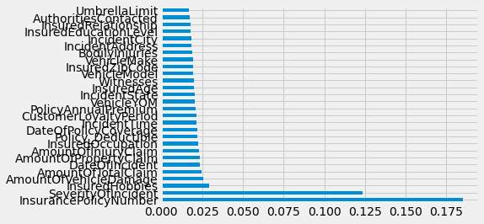
Dropping columns with Unique Values
From Extra tree classifier , by using feature_importances_
I visualized and came to know which is important features in the dataset

Slide 13
Dropped some columns which are not much impacting on my target variables
Dropped Columns:
* AuthoritiesContacted
* Policy_CombinedSingleLimit
* CapitalLoss
* CapitalGains
* TypeOfCollission
* VehicleID
* NumberOfVehicles
* TypeOfIncident
* InsuredGender
* PoliceReport
After dropping columns my dataset shape was (28836, 28)

Slide 14
Repeated all the steps to my test dataset as per my train dataset

Slide 15
Exploratory Data Analysis

Slide 16
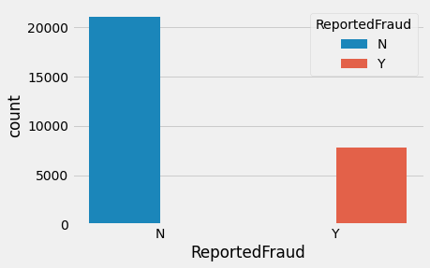
ReportedFraud info:
From this we came to know around 37% of Fraud is Reported , We should try to avoid as many false positives as we can. Let’s try to look for an indicative variable.

Slide 17
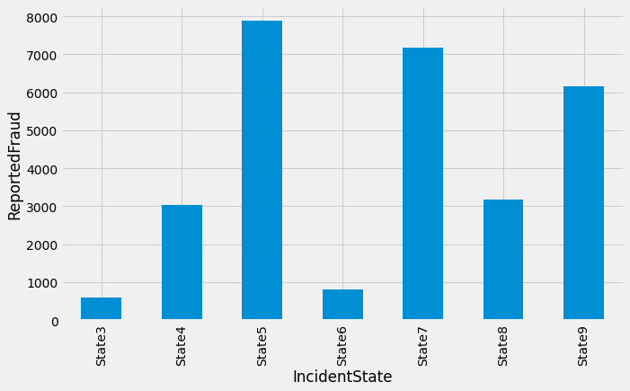
IncidentState:
Here I visualized IncidentState with respect to reported Fraud ,

Slide 18
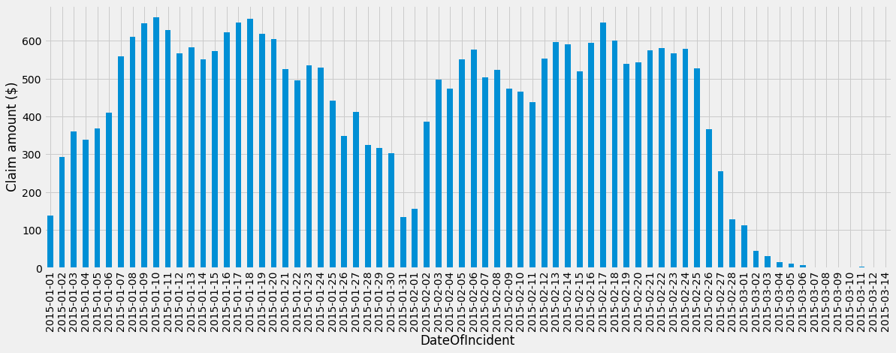
DateOfIncident
We see that, all the cases in above plot are mostly form the months of January and February 2015

Slide 19
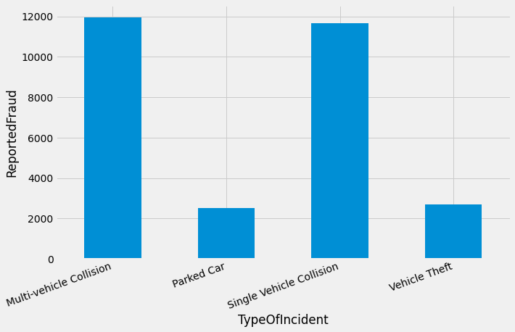
TypeOfIncident
from here we came to know that multi-vehicle and single-vehical collision are claimed more

Slide 20
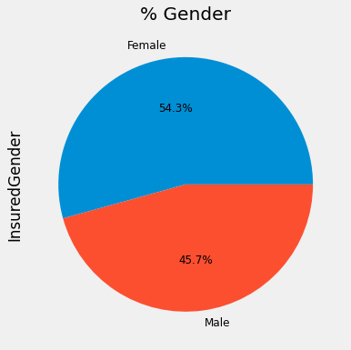
InsuredGender
Here we came to know around
54.3% of insured is Females

Slide 21
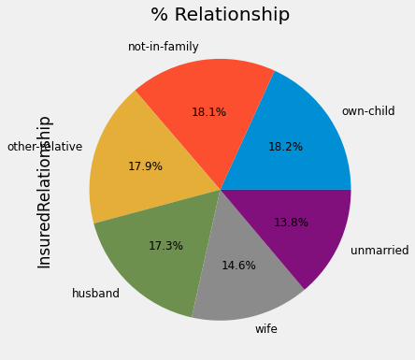
InsuredRelationship

Slide 22
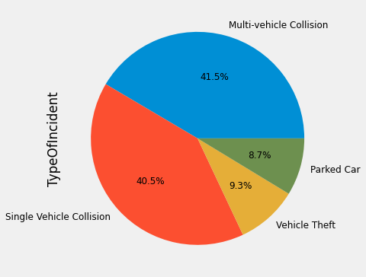
TypeOfIncident

Slide 23
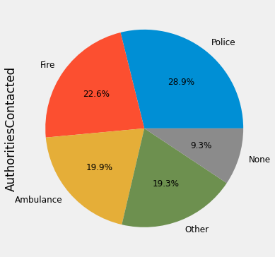
AuthoritiesContacted

Slide 24
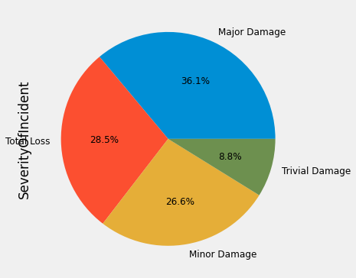
SeverityOfIncident

Slide 25
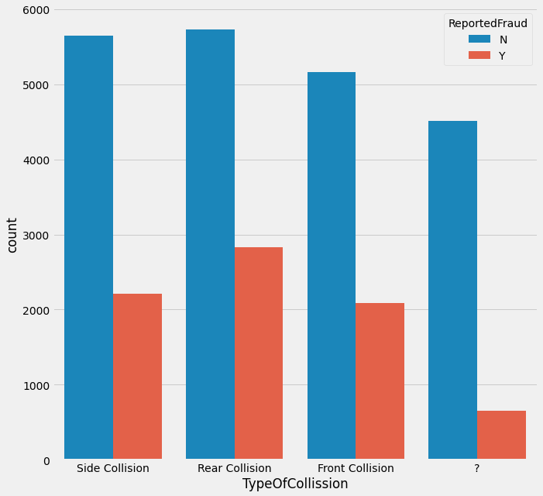
TypeOfCollission

Slide 26
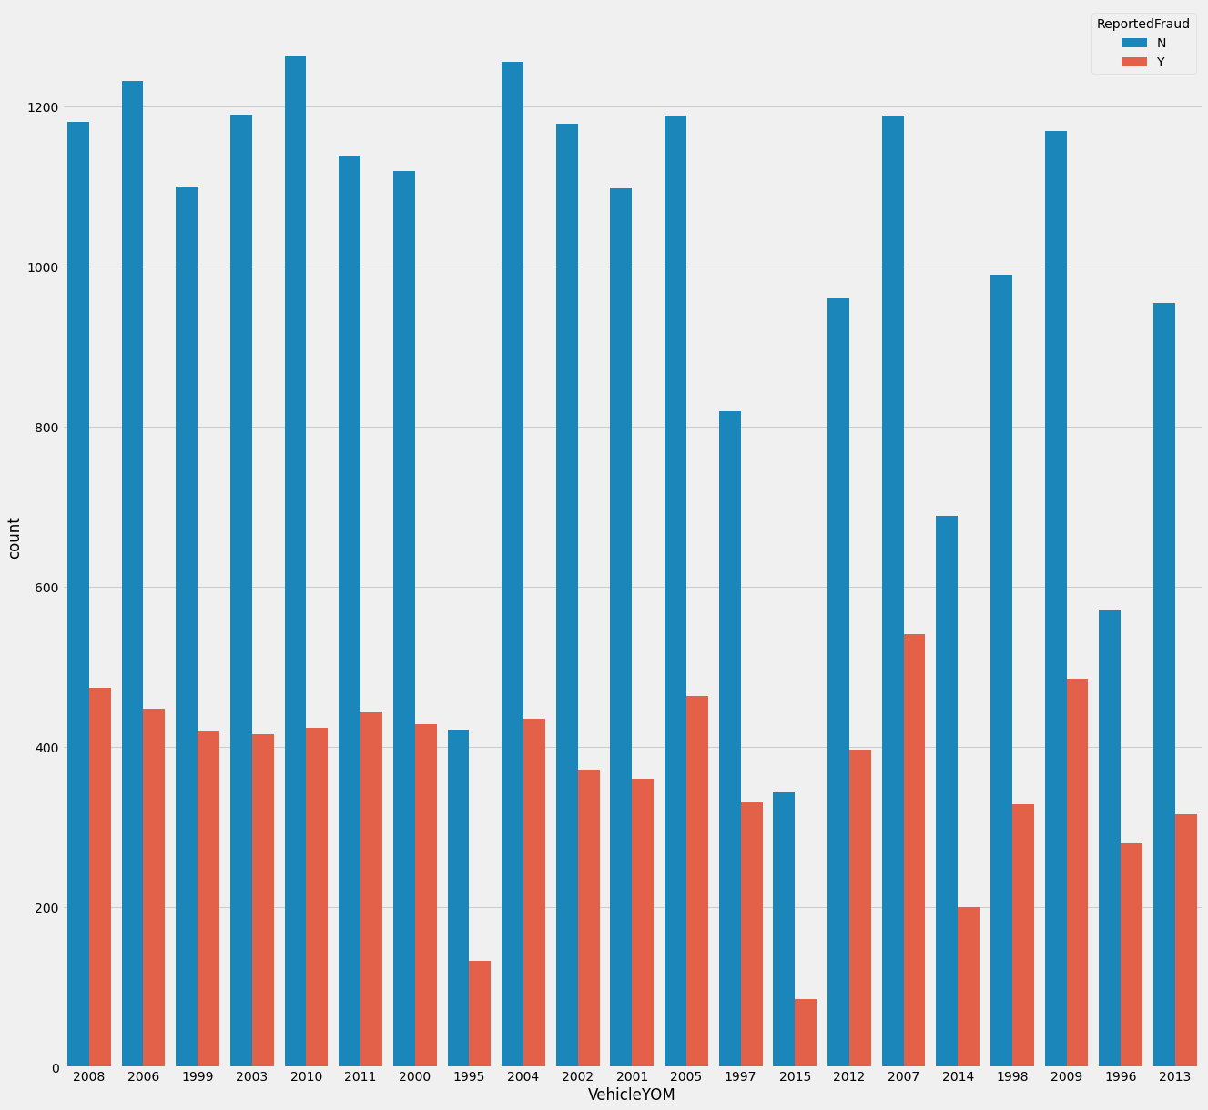
VehicleYOM

Slide 27
Models and Approaches

Slide 28
Normalization:
I used MinMaxScaler for normalizing the test and train data
by doing this all the values will be in the range of 0-1

Slide 29
Models Used
Predictive Model used is RandomForestClassifier and Decision Tress Classifier
RandomForestClassifier gave best performance, so results for that have been shown.

Slide 30
Random Forest Classifier
Accuracy = 92.84
Cohen Kappa = 0.813
Recall = 80.3
This was the performance I got for my modelby using Random Forest Classifier

Slide 31
Prediction
The predicted values are:
0’s = 7535( not reported Fraud)
1’s = 1377( reported fraud)

Slide 32
Insights and Business Decisions
Claims to be targeted:
Having atleast one witness
Insureds reporting claims for major damage
Female gender are mostly claimed
Claim amount and insured education level are also important features as evidenced by model feature importance
There is also a need to increase police reports on claims made as it can serve as an initial screen for fraudulent claims

Slide 33
THANKING YOU

